Slide 1
SCSA1104-Problem Solving Techniques with C and C++
By
T.Judgi
Associate Professor
Department of Computer Science and Technology
Sathyabama Institute of Science and Technology

Slide 2
UNIT - II
Introduction to C
Features of C
Structure of C program
Data Types
‘C’ Tokens
Input/output statements
Control Statement
Functions
Types of Functions
Recursion
Algorithms
Reversing the digits of a number
Generation of Fibonacci sequence
Factorial Computation

Slide 3
History of C
S.No | Language | Year | Developed by
1 | Algol | 1960 | International Group
2 | BCPL | 1967 | Martin Richard
3 | B | 1970 | Ken Thompson
4 | Traditional C | 1972 | Dennis Ritchie
5 | K & R C | 1978 | Kernighan & Dennis Ritchie
6 | ANSI C | 1989 | ANSI Committee
7 | ANSI/ISO C | 1990 | ISO Committee
8 | C99 | 1999 | Standardization committee

Slide 4
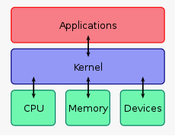
C language
The C Language is developed by Dennis Ritchie for creating system applications that directly interact with the hardware devices such as drivers, kernels, etc.
C programming is considered as the base for other programming languages, that is why it is known as mother language.
Figure 1:Kernel (Operating System)

Slide 5
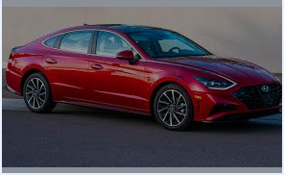
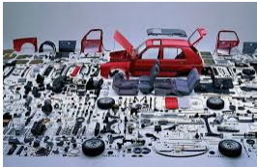
What is C language?
It can be defined by the following ways:
Mother language
Compilers,JVM,Kernel
Programming Languages eg. C++,C#, Java
Provides Core Concepts like arrays,strings,functions,file handling
System programming language
Used to interact with hardware devices, OS, drivers, kernels, etc. For example, Linux kernel is written in C.
Procedure-oriented programming language
Specifies a series of steps for the program to solve the problem.
Structured programming language
Mid-level programming language

Slide 6
Features of C Language
Simple
Machine Independent or Portable
Mid-level programming language
structured programming language
Rich Library
Memory Management
Fast
Pointers
Recursion
Extensible

Slide 7
Structure of a C program

Slide 8
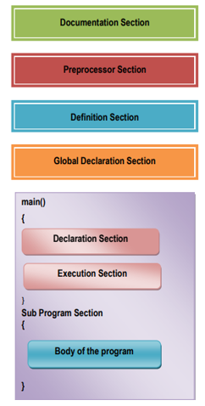
Structure of a C program

Slide 9
Structure of a C program
Document Section
A comment is an explanation or description of the source code of the program. It helps a developer explain logic of the code and improves program readability.
At run-time, a comment is ignored by the compiler.
There are two types of comments in C:
1) Single line comment
2) Multi Line Comment
Single Line Comment | Multi Line Comment
// Single line comment | //Multi Line Comment //Line 1 //Line 2 (Or) /* Multi line comment are used in the program Line 1… Line 2…. ….., ……… */

Slide 10
Example Program
// C program to illustrate
// use of multi-line comment
#include <stdio.h>
int main()
{
/*In main function I am going to write printf
statement
Line 1
Line 2…*/
// Single line Welcome user comment
printf("Welcome to Sathyabama");
return 0;
}

Slide 11
Structure of a C program
Preprocessor Section or Link Section or Header File Section
The link section provides instructions to the compiler to link functions from the library. Syntax: #include<filename>
Example:
#include<stdio.h>
#include<math.h>
#include<string.h>
Example Program
#include <stdio.h>
#include <conio.h>
int main()
{
return 0;
}

Slide 12
Structure of a C program
Definition Section
The definition section defines all symbolic constant.
Symbolic constant is a way of defining a variable constant whose value cannot be changed
Syntax:
#define symbolic constant value
Example
#define MAX 100
#define PI 3.14

Slide 13
Example Program: Definition Section
#include <math.h>
#define PI 3.1416
#define MAX 180
main ( )
{
int angle;
float x,y;
angle = 0;
printf(“ Angle Cos(angle)\n\n”);
while(angle <= MAX)
{
x = (PI/MAX)*angle;
y = cos(x);
Overview of C 13
printf(“%15d %13.4f\n”, angle, y);
angle = angle + 10;
} }

Slide 14
Structure of a C program
Global Declaration Section:
The variables that are used in more than one function throughout the program are called global variables.

Slide 15
Structure of a C program
main()
Every ‘C’ program must have one main() function.
It contains the following two parts
Declaration Part:
This part is used to declare the entire variables that are used in the executable part of the program and these are called local variables
Execution Part:
It contains at least one valid C Statement.
The Execution of a program begins with opening brace ’{‘ and ends with closing brace ’}’
The closing brace of the main function is the logical end of the program
All statements should end with a semicolon(;)

Slide 16
Structure of a C program
Sub Program section:
Sub programs are basically functions are written by the user (user defined functions)
User defined functions are placed immediately after the main function. Eg. Function
This is optional to the programmer eg. Addition Program
Constraints while writing a C program
All statements in ‘C’ program should be written in lower case letters.
Uppercase letters are only used for symbolic constants
Blank space may be inserted between the words. Should not be used while declaring a variable, keyword, constant and function
The program statements can be written anywhere between the two braces following the declaration part
All the statements should end with a semicolon (;)

Slide 17
Example : Structure of a C program
// Program to illustrate structure of C program // Document section //Single line comment
#include<stdio.h> // Link Section
#define PI 3.14; // Definition Section
float area(float r); // Global Declaration section
int main() //Main Function
{
float r; // Declaration Part
printf(" Enter the radius:n"); // Executable Part
scanf("%f",&r);
printf("the area is: %f",area(r));
return 0;
}
float area(float r)
{
return pi * r * r; //sub program or User defined function
}

Slide 18
#include<stdio.h>
#include<conio.h> //console input output
main()
{
Int a;
printf(“Enter the value of a/n”);
Scanf(“%d”,&a);
printf(“%d”,a);
getch(); //predefined function
}
# ->preprocessor
Stdio->standard input and output
.h->Extension
main() -> main function
{ - >staring of the program
Int -> integer data type
a-> variable name
Printf-> print formatted
scanf->scan formatted
% ->conversion specification
d-> data type character
%d -> control string or formatted string

Slide 19
Executing a ‘C’ Program
Compilation and Execution of C program
1. Creating the program
2. Compiling the Program
3. Linking the Program with system library
4. Executing the program

Slide 20
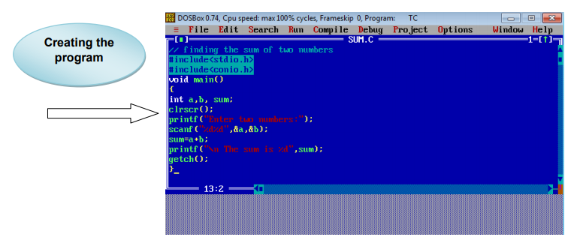
Creating the program

Slide 21
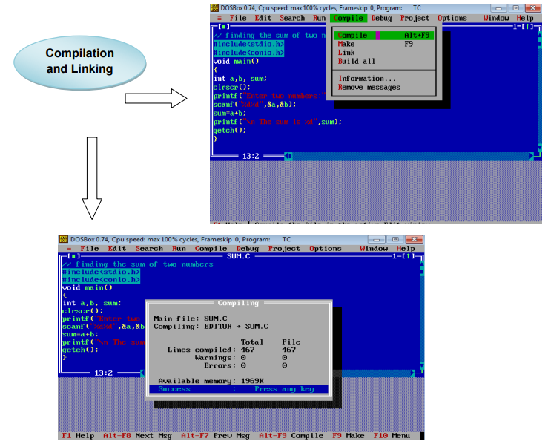
Compiling and Linking

Slide 22
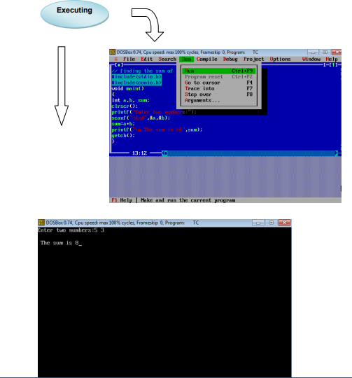
Executing the program

Slide 23
Character Set, Tokens and Variables
Alphabet
Words
Sentence
Paragraph
Character Set, Tokens and Variables
Based on grammar or Syntax rule
Based on grammar

Slide 24
Character Set
The characters that can be used to form words, numbers and expressions.
The characters in c are grouped into the following categories:
1. Letters
2. Digits
3. Special Characters
4. White Spaces
White spaces may be used to separate words, but are prohibited between the characters of keywords and identifiers.

Slide 25
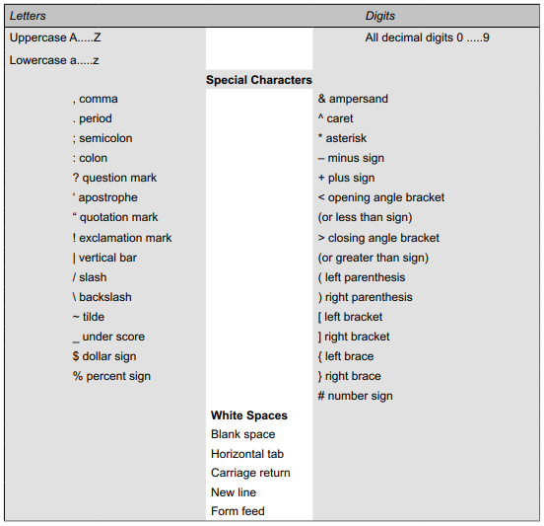
Table : Character Set

Slide 26
C- Tokens
In a passage of text, individual words and punctuation marks are called tokens. Similarly, in a C program the smallest individual units are known as C tokens
C has six types of tokens and programs are written using these tokens and the syntax of the language.
Figure : C Tokens
C Tokens
Keywords
Constants
Strings
Operators
Float
While
-15.7
66
“ABC”
“year”
+,-*,/,%
Identifiers
Special Symbols
Main
amount
[], {}

Slide 27
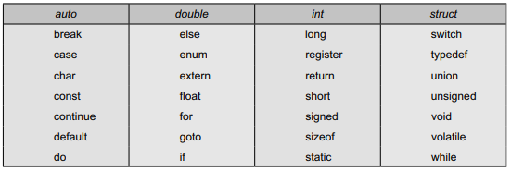
Keywords
Every C word is classified as either a keyword or an identifier. All keywords have fixed meanings and these meanings cannot be changed.
Keywords serve as basic building blocks for program statements.
All keywords must be written in lowercase.
Keywords cannot be used as normal identifiers names.
Table : ANSI C Keywords

Slide 28
Identifiers
Identifiers refer to the names of variables, functions and arrays. These are user-defined names and consist of a sequence of letters and digits, with a letter as a first character.
Both uppercase and lowercase letters are permitted.
The underscore character is also permitted in identifiers.
Rules for Identifiers
1. First character must be an alphabet (or underscore).
2. Must consist of only letters, digits or underscore.
3. Cannot use a keyword.
4. Must not contain white space
Example :
int num;
char name;
Sum() // where num and name, sum are identifier names.

Slide 29
Constants
Constants in C refer to fixed values that do not change during the execution of a program.
C supports several types of constants as illustrated in Figure.
Figure : Constants
Constants
Numeric Constants
Character Constants
Integer Constant
Real Constant
Single characters constants
String Constants

Slide 30
Constants
Integer Constant:
An integer constant refers to a sequence of digits.
Example:
– 321 0 654321 +78
Real or floating point constants:
Integer numbers are inadequate to represent quantities that vary continuously, such as distances, heights, temperatures, prices, and so on.
These quantities are represented by numbers containing fractional parts like 17.548.
Such numbers are called real (or floating point) constants.
Example:
0.0083 –0.75 435.36 +247.0

Slide 31
Constants
Single character constants
A single character constant (or simply character constant) contains a single character enclosed within a pair of single quote marks.
Example
‘5’ ‘X’ ‘;’ ‘ ’
String constants
A string constant is a sequence of characters enclosed in double quotes. The characters may be letters, numbers, special characters and blank space.
Examples
“Hello!” “1987” “WELL DONE” “?...!” “5+3” “X”

Slide 32
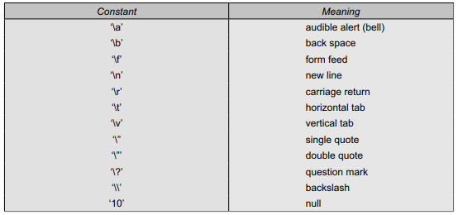
Constants
Backslash character constants
C supports some special backslash character constants that are used in output functions.
For example, the symbol ‘\n’ stands for newline character.
Each one of them represents one character, although they consist of two characters.
These characters combinations are known as escape sequences.
Table: Backslash character constants

Slide 33
Variables
A variable is a data name that may be used to store a data value.
Unlike constants that remain unchanged during the execution of a program, a variable may take different values at different time during execution.
A variable name can be chosen by the programmer in a meaningful way.
Example
Average
Height
Total
Counter_1
class_strength
variable names may consist of letters, digits, and the underscore(_) character

Slide 34
Variables
Conditions to write variable name
They must begin with a letter.
Length should not be normally more than eight characters, since only the first eight characters are treated as significant by many compilers.
Uppercase and lowercase are significant.
It should not be a keyword.
White space is not allowed

Slide 35
Variables
Some examples of valid variable names are:
John
Value
T_raise
Delhi
x1
ph_value
mark
sum1
distance
Invalid examples include:
123
(area)
%
25th

Slide 36
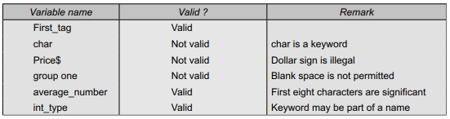
Variables
Table : Examples of Variable Names

Slide 37
Data Types
A data type specifies a type of data that a variable can store such as integer, float or character.
ANSI C supports three classes of data types:
1. Primary (or fundamental) data types
2. Derived data types
3. User-defined data types
Five fundamental data types:
integer (int) - 2 byte
character (char) -1 byte
floating point (float) - 4 byte
double-precision floating point (double) -8 byte
Void
The void type has no values. This is usually used to specify the type of functions. The type of a function is said to be void when it does not return any value to the calling function.

Slide 38

Data Types
Table: Size and Range of Basic Data Types on 16-bit Machines

Slide 39
Declaration of Variables
After designing suitable variable names, we must declare them to the compiler.
Declaration does two things:
1. It tells the compiler what the variable name is.
2. It specifies what type of data the variable will hold.
The declaration of variables must be done before they are used in the program.
Syntax:
Data_type v1;
data-type v1,v2,....vn ;
eg: int sum; or char s;
Example:
int count;
int number, total;
double ratio;
Char e, s;

Slide 40
Declaration of Variables
int number; // Declaration of variables
number
garbage
10
Address 0
Address 1
Address 2
Address 3
Address 4
Address 5
Address 6
Address n
Memory address
Eg:5001

Slide 41
Assigning values to the variables
Values can be assigned to variables using the assignment operator = as follows:
Syntax:
variable_name = constant;
Example
a=10;
It is also possible to assign a value to a variable at the time the variable is declared.
Syntax:
data-type variable_name = constant;
Examples
int final_value = 100;
char yes = ‘s’;
double balance = 75.84;

Slide 42
Initialization
The process of giving initial values to variables is called initialization.
C permits the initialization of more than one variables in one statement using multiple assignment operators.
Example
p = q = s = 0;
x = y = z = MAX;

Slide 43
Reading data from keyboard
Why do we need to read input values from keyboard?
Another way of giving values to variables is through keyboard using scanf function.
Syntax: to print one variable
scanf (“control string”,& variable name); //control string or format specifier
Example : scanf(“%d”,&number);
Syntax: to print more than one variable
scanf(“control string”,&variable1,&variable2,…);
Example: scanf(“%d %d”, &a,&b);
The control string contains the format of data being received.
Ampersand symbol (&) – operator- which indicates the variable name’s address.
Printf(“format specifier”, variable name);

Slide 44
Different forms of main statement
main()
main(void)
int main()
void main()
void main(void)
int main(void)

Slide 45
Operators and Expressions

Slide 46
Operators
C supports a rich set of built-in operators.
An operator is a symbol that tells the computer to perform certain mathematical or logical manipulations.
Operators are used in programs to manipulate data and variables.
Arithmetic operators
Relational operators
Logical operators
Assignment operators
Increment and decrement operators
Conditional operators
Bitwise operators
Special operators

Slide 47
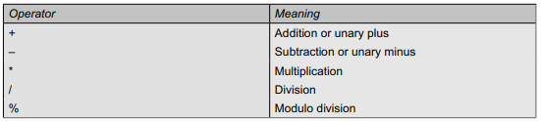
Arithmetic operators
C provides all the basic arithmetic operators such as +, –, *, and /
Integer division truncates any fractional part.
The modulo division operation produces the remainder of an integer division.
Examples
a – b a / b
a + b a % b
a * b –a * b
Arithmetic Operators can be classified as:
Integer Arithmetic
Real Arithmetic
Mixed mode Arithmetic

Slide 48
Arithmetic operators
Integer arithmetic
When both the operands in a single arithmetic expression such as a+b are integers, the expression is called as integer expression and the operation is called integer arithmetic.
Example
a=14, b=4;
Here in the above example we are using only integer values.
Operation | Output
a+b | 18
a-b | 10
a*b | 56
a/b | 3 (decimal part truncated)
a%b | 2( remainder of division)

Slide 49
Arithmetic operators
Real arithmetic
An arithmetic which is involving real values(decimal values) is called real arithmetic.
If x, y, and z are floats, then we will have:
x = 6.0/7.0 = 0.857143
y = 1.0/3.0 = 0.333333
z = –2.0/3.0 = –0.666667
Mixed mode arithmetic
when one operand is integer and another is real i.e both the types of variables (integer and real) values are used for operation is called as mixed more arithmetic.
E.g. Float a=10.5; Int b=30; C=a+b; //c=40.5
Eg. 15/10.0 =1.5
This type of expression that c=a+b is called an mixed arithmetic.

Slide 50
Arithmetic operators:Example program
#include<stdio.h>
#include<conio.h>
main ()
{
int months, days ;
printf(“Enter days\n”) ;
scanf(“%d”, &days) ;
months = days / 30 ;
printf(“Months = %d” , months) ;
}

Slide 51
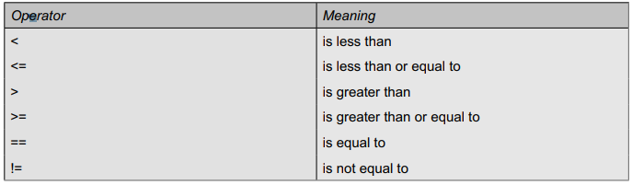
Relational Operators
We often compare two quantities, and depending on their relation, take certain decision.
For example, we may compare the age of two persons, or the price of two items, and so on.
These comparisons can be done with the help of relational operators.
An expression such as a < b or 1 < 20 containing a relational operator is termed as a relational expression. The value of a relational expression is either one or zero. It is one if the specified relation is true and zero if the relation is false. For example 10 < 20 is true but 20 < 10 is false
Table : Relational Operators

Slide 52
Relational Operators
Example Program:
#include<stdio.h>
#include<conio.h>
void main()
{
int a=10, b=20;
if(a > b)
{
printf(“A is Largest\n");
}
else
{
printf(“B is Largest\n");
}
}
Salary <15000
deduct PF
CGPA >9.8
Topper
Username == password
goto next page
Username != password
Invalid credentials

Slide 53
Logical operators
The logical operators are used when we want to check more than one condition and make decision.
Example
a > b && x == 10
&& meaning logical AND
|| meaning logical OR
! meaning logical NOT
if(a>b && a>c)
{
printf(“a is greater”);
}
else
{
printf(“a is not greater”);
}
It combines two or more relational expressions
salary >100000 && Experience >20
Eligible to take loan
Attendance >95% && CGPA >9.8
University topper

Slide 54
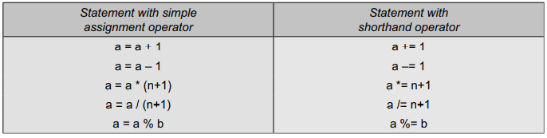
Assignment operators
Assignment operators are used to assign the result of an expression to a variable.
a=10
c=a+b;
C has a set of ‘shorthand ’ assignment operators of the form
v op= exp;
Where v is a variable, exp is an expression and op is a C binary arithmetic operator.
The operator op= is known as the shorthand assignment operator.
The assignment statement v op= exp;
C has a set of ‘shorthand ’ assignment operators of the form

Slide 55
Assignment operators Example
#include <stdio.h>
int main()
{
int number1, number2, sum;
printf("Enter two integers: ");
scanf("%d %d", &number1, &number2);
// calculating sum
sum = number1 + number2;
printf("%d %d %d", number1, number2, sum);
return 0;
}

Slide 56
Increment and decrement operators
If you use the ++ operator as prefix like: ++var. The value of var is incremented by 1 then, it returns the value.
If you use the ++ operator as postfix like: var++. The original value of var is returned first then, var is incremented by 1.
A prefix operator first adds 1 to the operand and then the result is assigned to the variable on left. Eg. ++var
On the other hand, a postfix operator first assigns the value to the variable on left and then increments the operand.eg. var++
Example:
++m; is equivalent to m = m+1; (or m += 1;) - - m; is equivalent to m = m–1; (or m – = 1;)
m=10
a=++m
a = 11
b = m++
b = 10

Slide 57
Example: Increment and decrement operators
#include<stdio.h>
#include<conio.h>
void main()
{
int var1=5,var2=7;
printf(“%d”,var1++);
printf(“%d”,++var2);
getch();
}

Slide 58
Conditional Operator
A ternary operator pair “? :” is available in C to construct conditional expressions of the form
Syntax:
exp1 ? exp2 : exp3
where exp1, exp2, and exp3 are expressions.
The operator ? : works as follows: exp1 is evaluated first. If it is nonzero (true), then the expression exp2 is evaluated and becomes the value of the expression. If exp1 is false, exp3 is evaluated and its value becomes the value of the expression. Note that only one of the expressions (either exp2 or exp3) is evaluated. For example, consider the following statements.
a = 10;
b = 15;
x = (a > b) ? a : b;
In this example, x will be assigned the value of b. This can be achieved using the if..else statements as follows:
if (a > b)
x = a; else x = b;

Slide 59
Example:
#include<stdio.h>
#nclude<conio.h>
void main()
{
int age;
printf(Enter your age ");
scanf("%d",&age);
(age>=18)?printf("eligible for voting")):printf(“Not eligible for voting"))
getch();
}

Slide 60
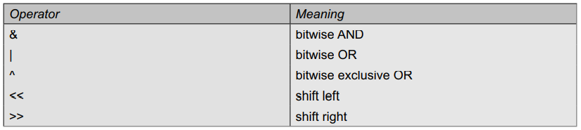
Bitwise operators
C has a distinction of supporting special operators known as bitwise operators for manipulation of data at bit level.
These operators are used for testing the bits, or shifting them right or left. Bitwise operators may not be applied to float or double.
Table lists the bitwise operators and their meanings.

Slide 61
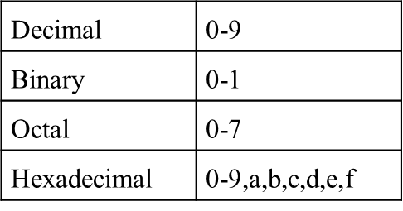
Bitwise operators
Number System
Logic gates | Symbol
AND | &
OR | |
XOR | ^
NOT | ~

Slide 62
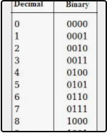
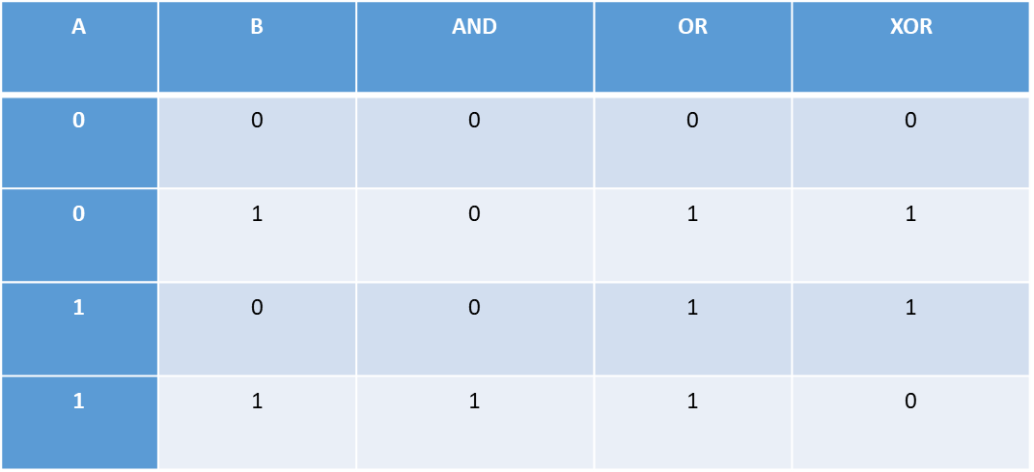
Bitwise operators
Truth Table
8421
5 |6
5->0101
6->0110
7->0111

Slide 63
Special Operators
C supports the following special operators
Comma operator
Sizeof operator
Pointer operators (& and *)
Member selection operators (. and –> ).

Slide 64
Comma operator
The comma operator can be used to link the related expressions together.
A comma-linked list of expressions are evaluated left to right and the value of right-most expression is the value of the combined expression.
Example
value = (x = 10, y = 5, x+y);
First assigns the value 10 to x, then assigns 5 to y, and finally assigns 15 (i.e. 10 + 5) to value.
Since comma operator has the lowest precedence of all operators, the parentheses are necessary.

Slide 65
Sizeof Operator
The sizeof is a compile time operator and, when used with an operand, it returns the number of bytes the operand occupies.
Examples:
m = sizeof (sum);
n = sizeof (long int);
k = sizeof (235L);
The sizeof operator is normally used to determine the lengths of arrays and structures when their sizes are not known to the programmer.
It is also used to allocate memory space dynamically to variables during execution of a program.

Slide 66
Managing input and output operations
Agenda
Reading a Character
Writing a character
Formatted I/O

Slide 67
Reading a Character
Reading a single character can be done by using the function getchar.
Syntax
variable_name = getchar( );
Example:
char name;
name = getchar();
Examples
Do you want to continue the transaction?
Enter ‘Y’ for yes and ‘N’ for No
Enter your gender
Enter ‘M’ for Male and ‘F’ for Female

Slide 68
Reading a Character
OUTPUT
Do you want to continue the transaction?
Type Y for YES and N for NO:
Y
Enter your PIN
Program
#include <stdio.h>
main()
{
char answer;
printf(“ Do you want to continue the transaction?\n”);
printf(“Type Y for YES and N for NO: “);
answer = getchar(); // Reading a character.
if(answer == ‘Y’ || answer == ‘y’)
printf(“\n\nEnter your PIN \n”);
else
printf(“\n\n\n Exit ”);
}

Slide 69
Reading a Character
//Program to test character (number,alphabet,symbol)type
#include <stdio.h>
#include <ctype.h>
main()
{
char character;
printf(“Press any key\n”);
character = getchar();
if (isalpha(character) > 0) // Test for letter
printf(“The character is a letter.”);
else
if (isdigit (character) > 0) // Test for digit
printf(“The character is a digit.”);
else
printf(“The character is not alphanumeric.”);
}
When you enter mobile number
Enter Only numbers
When you sign up in gmail
Your password should be a combination of number, symbol, alphabet

Slide 70
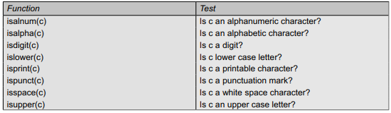
Character test functions
Character test functions

Slide 71
Writing a character
Writing a single character can be done by using the function putchar
Syntax
putchar (variable_name);
Example:
answer = ‘Y’;
putchar (answer);
Int main()
{
char answer;
printf("Do you want to continue the transaction?\n");
printf("Type Y for YES and N for NO:");
answer=getchar();
putchar(answer); // Writing a character.
return 0;
}

Slide 72
Formatted Input/Output
Another way of giving values to variables is through keyboard using scanf function.
Syntax: to print one variable
scanf (“control string”,& variable name); //control string or format specifier
Example : scanf(“%d”,&number);
Syntax: to print more than one variable
scanf(“control string”,&variable1,&variable2,…);
Example: scanf(“%d %d”, &a,&b);
The control string contains the format of data being received.
Ampersand symbol (&) – operator- which indicates the variable name’s address.
Printf(“format specifier”, variable name);

Slide 73
Decision making /Control Statement

Slide 74
WHAT IS CONTROL FLOW STATEMENTS
Control flow statements are blocks of code that control the flow of a program.
In other words, a control structure is a container for a series of function calls, instructions and statements.

Slide 75
TYPES OF CONTROL FLOW STATEMENTS
There are three types of control flow statements:
• Branching / Decision Making Statements/control statements
• Iterative / Looping Statements
• Jumping Statements

Slide 76
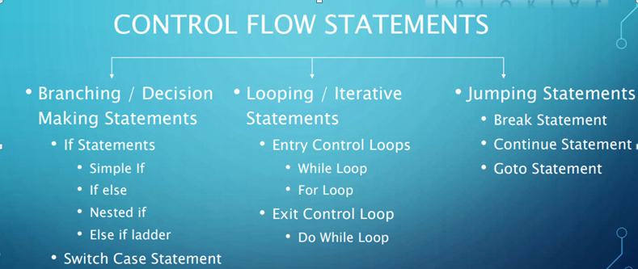
TYPES OF CONTROL FLOW STATEMENTS

Slide 77
Branching / Decision Making Statements/Conditional Statement

Slide 78
IF STATEMENTS – SIMPLE IF STATEMENT
Takes an expression in parenthesis and a statement or block of statements. If the expression is true then the statement or block of statements gets executed otherwise these statements are skipped.
Syntax:
if(Condition)
{
//Statements;
}
Statement x;
If(rainy)
Take umbrella
If(salary<15000)
Deduct PF
If(Grade==9.9)
Topper

Slide 79
SIMPLE IF- EXAMPLE
#include<stdio.h>
void main()
{
int a=5;
if(a%2==0)
{
printf(“number %d is even.”,a);
}
}
if gender == Female
Eligible for women's scholarship
if withdraw amount >40000
ATM cash withdrawal up to 40000 per day
if age >55
Person is retired

Slide 80
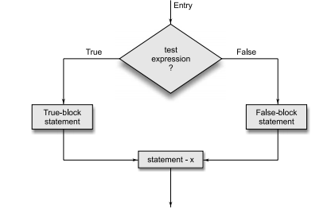
IF STATEMENT – IF ELSE STATEMENTS
Statements under if executes only, when the given condition is true.
Otherwise, the statements under else will be executed.
Syntax:
if(condition)
{
true statements;
}
else
{
false statements;
}
Statement x;

Slide 81
EXAMPLE –IF ELSE Statement
//Get a number from user and say whether it is even or odd number.
#include<stdio.h>
void main()
{
int a=5;
if(a%2==0)
{
printf(“number %d is even”,a);
}
else
{
printf(“number %d is odd”,a);
}
}
if User name == password
Goto next page
else
Invalid credential
if (red signal)
stop
else
move

Slide 82
Example2
//Calculation of gross salary
BS<1500
HRA->10%of BS +DA=90%
BS>=1500
HRA=500
DA=98% of BS

Slide 83
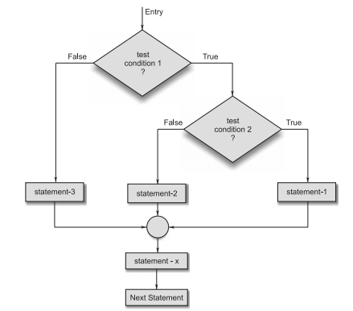
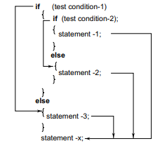
NESTED IF STATEMENTS
If within a If condition is called Nested If condition. It is a conditional statement which is used when we want to check more than 1 conditions at a time in a same program.
Syntax:

Slide 84
Example: Nested If…ELse
Case 1: a=5 ,b=6,c=8
Case 2: a=6,b=10,c=5
Case 3: a=10,b=6,c=8
#include<stdio.h>
void main() {
int a,b,c;
a=5, b=6, c=8;
if(a>b)
{
if(a>c) {
printf(“a is big”);
}
else {
printf(“c is big”);
} }
Else
{
if(b>c) {
printf(“b is big”);
}
else
{
printf(“c is big”);
}
getch(); }
If(5>6)
false
If(6>8)
False
C is big
If (6>10)
false
If(10>5)
True
Else
B is big
If (10>6)
True
If(10>8)
True
a is big

Slide 85
Example 2:
Incentive policy of giving bonus to all the deposit holder
A bonus of 2% of the balance is given to all the deposit holder irrespective of their balance.
And 5% is given to female account holders if their balance is more than Rs.5000
Logic
If(gender==female)
If(balance>5000)
bonus=0.05*balance
else bonus=0.02*balance
else bonus=0.02*balance
balance=balance+bonus

Slide 86
Dangling Else problem
Alternate Logic
If(gender==female)
if(balance>5000)
Bonus=0.05*balance;
else
bonus=0.02*balance;
Balance=balance+bonus;
Logic:
If(gender==female)
{
If(balance>5000)
Bonus=0.05*balance;
Else
bonus=0.02*balance;
}
else
{
bonus=0.02*balance;
}
Balance=balance+bonus;
Alternate Logic
If(gender==female)
if(balance>5000)
Bonus=0.05*balance;
else
bonus=0.02*balance;
Balance=balance+bonus;
“else is always paired with the most recent unpaired if”

Slide 87
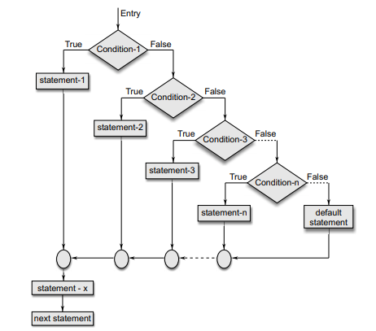
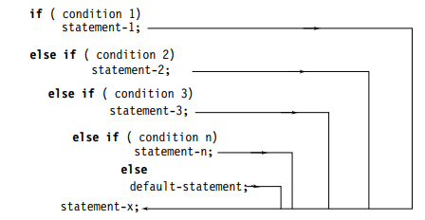
ELSE IF LADDER
A multipath decision is a chain of ifs in which the statement associated with each else is an if.
It takes the following general form:

Slide 88
Example 1- Program to find greatest of three numbers
void main()
{
int a,b,c;
a=5, b=6, c=7;
if(a>b&& a>c)
{
printf(“a is big”);
}
else if(b>c)
{
printf(“b is big”);
}
else
{
printf(“c is big”);
}
getch();
}
If(5>6)&&(5>7)
False
elseif (6>7)
False
C is big

Slide 89
Example 2- Else if Ladder
Let us consider an example of grading the students in an academic institution.
Average marks Grade
80 to 100 Honours
60 to 79 First Division
50 to 59 Second Division
40 to 49 Third Division
0 to 39 Fail
if (marks > 79)
grade = “Honours”;
else if (marks > 59)
grade = “First Division”;
if (marks > 79)
grade = “Honours”;
else if (marks > 59)
grade = “First Division”;
else if (marks > 49)
grade = “Second Division”;
else if (marks > 39) grade = “Third Division”;
else
grade = “Fail”;
printf (“%s\n”, grade);

Slide 90
Example2 - Else if ladder
An electric power distribution company charges its domestic consumers as follows:
Consumption Units Rate of Charge
0 – 200 Rs. 0.50 per unit
201 – 400 Rs. 100 plus Rs. 0.65 per unit excess of 200
401 – 600 Rs. 230 plus Rs. 0.80 per unit excess of 400
601 and above Rs. 390 plus Rs. 1.00 per unit excess of 600

Slide 91
Homework 2 – Else if ladder
Example
Grade selection based on score.
Here, if our score is more than 90, we will get S grade
If our score is in between 80 and 90, we will get A grade
If our score is in between 70 and 80, we will get B grade
If our score is in between 60 and 70, we will get C grade
If our score is in between 51 and 60, we will get D grade
If our score is 50, we will get E grade
Below 50 will be declared as U.

Slide 92
SWITCH CASE STATEMENTS
This is a multiple or multi way branching decision making statement. When we use nested if-else statement to check more than 1 condition then the complexity of a program increases in case of a lot of conditions.
Thus, the program is difficult to read and maintain. So to overcome this problem, C provides 'switch case'. Switch case checks the value of a expression against a case values, if condition matches the case values then the control is transferred to that point.

Slide 93
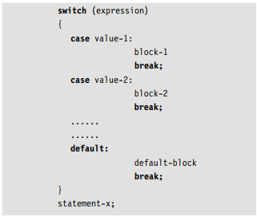
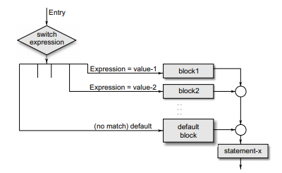
Switch Case
Syntax:

Slide 94
Example 1: Switch case
#include<stdio.h>
int main() {
int num=8 ;
switch(num) {
case 7:
Printf(“value is 7”);
Break;
case 8:
Printf(“value is 8”);
Break;
case 9:
Printf(“value is 9”);
Break;
default: printf(“out of range”); } return 0; }

Slide 95
Example 2 –Switch case
#include<stdio.h>
int main(){
int num=2;
Switch(num+2)
{
case 1:
Printf(“case 1: value is %d”,num);
break;
case 2:
Printf(“case 2: value is %d”,num);
break;
Case 3:
Printf(“case 2: value is %d”,num);
break;
Default:
Printf(“Default value is %d”,num);
}
Return 0;
}
Num
1024
2
Switch((2+2)
Switch(4)
Default value is 4

Slide 96
Int main()
{
Int a,b,num;
Printf(“Enter the values of a and b”);
Scanf(“%d %d”,&a,&b);
Printf(“Enter your choice\n 1.for addition\n2.for subtraction\n);
Scanf(“%d”,&num);
Switch(num)
{
Case 1:
Printf(“sum result is=%d\n”,a+b);
Break;
Case 2:%
Printf(“sub result is = %d\n”,a-b);
Case 3:
Printf(“mul result is= %d\n”,a*b);
Break;
Case 4:
Printf(“div result is=%d\n”,a/b);
break:;
Default:
Printf(Enter valid choice”);
}
Getch();
}

